Slide 1
STERLING
E-COMMERCE

Slide 2
STERLING
E-COMMERCE BUSINESS PERFORMANCE REVIEW
By
:
Ololade Akande
DATA INSIGHTS SHOWING CUSTOMER EXPERIENCE & BUSINESS PERFORMANCE AT STERLING E-COMMERCE

Slide 3
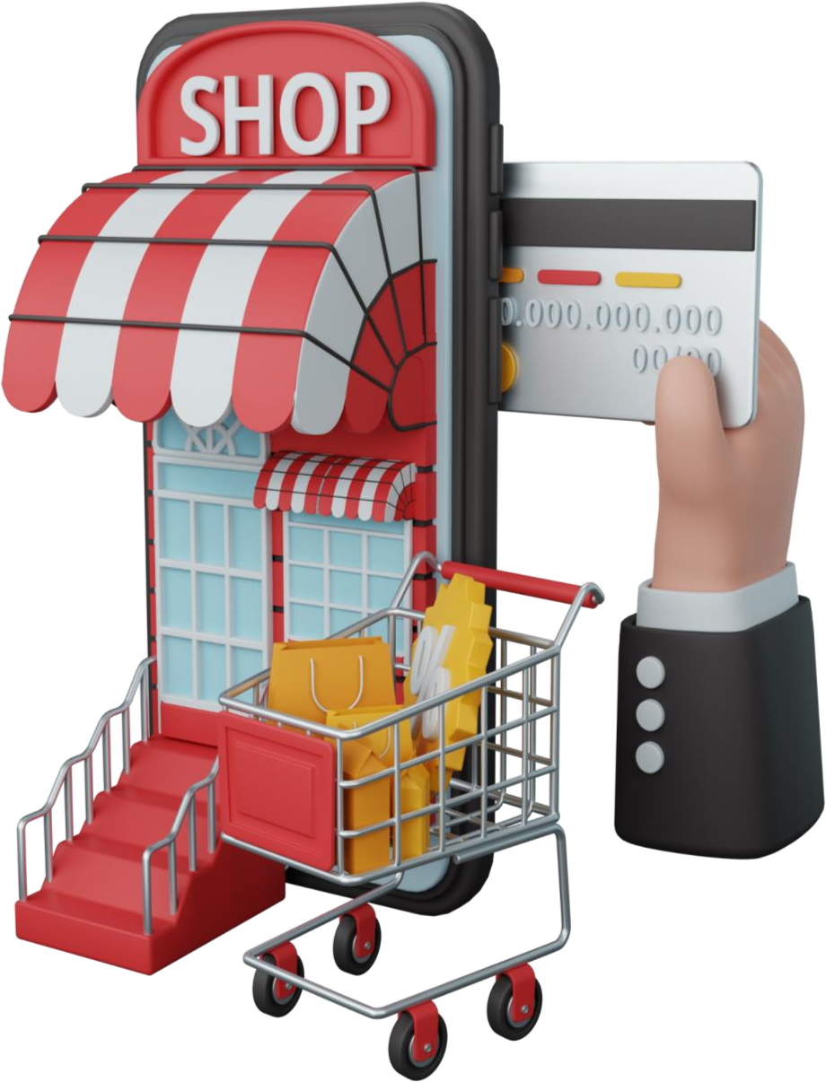

PROJECT RATIONALE
Actionable Insights for Growth provide targeted recommendations and data-driven insights that empower Sterling E-Commerce to make informed decisions which improve customer satisfaction and the company's overall business growth.
Operational Optimization & Revenue Increase
optimize product offerings (match customers choices/demand)
streamline processes (improve inventory management, logistics and payment processes
Increase customer experience (personalized marketing) and retention
Notes:
Making e-commerce a more customer centric business: accessible products in warehouse near packing areas, best shipping routes for delivery/affordable best shipping companies,
inventory management: stock levels for future demands avoiding excess stock, etc
Targeting marketing messages based on customers interests, preferences and past interactions with company/purchases e.g. email personalisation, product recommendations based on searches or orders, targeted discounts if regularly buy say men’s fashion, can receive special offer of 15% discount on your next men’s fashion purchase. This ais to make customers feel understood and appreciated by offering them relevant content and offers.

Slide 4

AGENDA
Sales Trends & Product Performance
Geographical Sales Distribution – Region/States
Product Orders
Customer Retention/Loyalty
Payment Method Segmentation
Conclusions & Recommendations

Slide 5
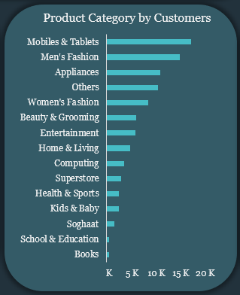
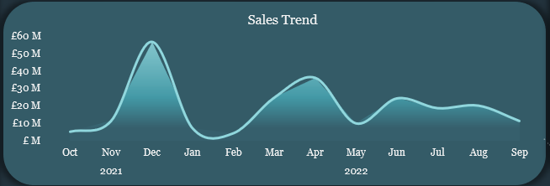
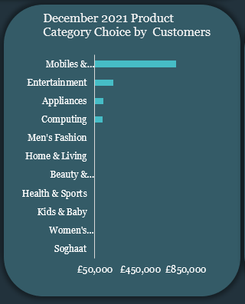
Sales Trend & Product Performance
Seasonal Sales Patterns – Analysis of company sales data reveal significant peak order volume and revenue during December 2021: Generates over 50 million pounds in revenue, indicating a peak in consumer spending.
- April 2022, yields approximately 30 million pounds, significantly higher than other months so far.
Product Performance – Further analysis in December 2021 shows Mobiles & Tablets followed by Men’s Fashion and Appliances contributing majorly to sales/revenue, highlighting distinct consumer behavior patterns throughout the year.
Notes:
- Dec. 2021, April, Jul and Aug 2022 are high sales period possibly due to seasons: festivities – Christmas, Easter and Summer/vacations. This can support planning inventory management, marketing campaigns. Notice steady growth in sales feb, mar to peak April then decline in may and sept after seasonals. This shows customer preferences for these specific times of the year. Category Analysis: Shows which category (mobiles & tablets) contributes mostly to total sales and ones underperforming (books, Sch & Education). Helps optimise product mix, show which gives higher return on investments or lower margins, informing product offering and pricing strategy expanding product lines in popular categories or running targeted marketing for underperforming ones

Slide 6
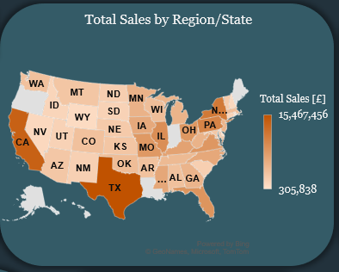
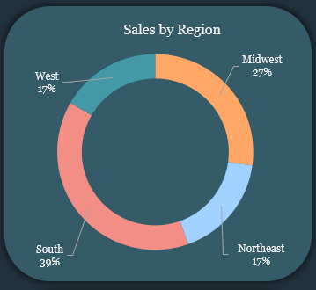
Geographical Sales Distribution – Region/States
Total Orders – 283,083 orders placed across the U.S., with Texas leading with the highest number, followed by California, both accounting for over 28,000 orders.
Regional Orders Breakdown:
Southern region: 39% of total orders, showing the highest concentration of customers.
Midwest: 27% of total orders.
Northeast and West 17%, respectively.
Regional Performance – The map highlights orders distribution across various categories, illustrating the spread of customer demand throughout the United States. Although lowest sales in RI(Northeast), DE(South) and WY(West) indicating potential for expansion.
Notes:
Shows sales distribution by geographical location, city TX and region Southern. To know customer profiles and where majority numbers of the customers are coming from and which regions/segments are most profitable. Insight which customer group/segment is this (age range 25-34, females/males) to guide personalised marketing strategies. Understand strong markets and areas with growth potential. Spot new vs. returning customers

Slide 7
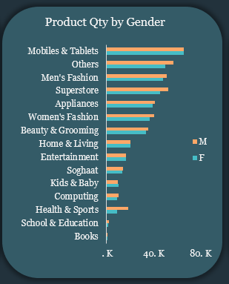
Product Orders – Gender Based
Total Quantity – Over 851,000 orders of different product categories by customers, with Mobiles & Tablets being the top-selling items, accounting for over 133,000 total for male and female.
- Books are the least-ordered product, with just over 2,100 items being sold.
Gender Performance – Data shows male customers order more on the average as female customers, indicating slightly stronger purchasing trend among males.
Notes:
Order analysis: spread of number of items per order or order frequency by gender, shows buying behaviour e.g. frequency of purchases, average order sizes.

Slide 8
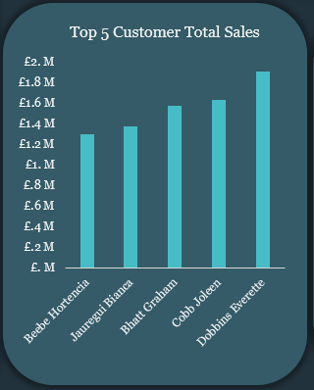
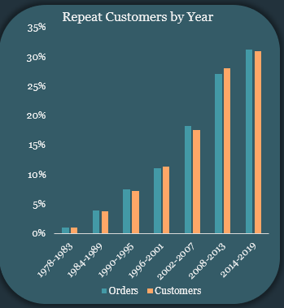
Customer Retention/Loyalty
Top Customers – more than £7M of total revenue (£231M) generated from 5 loyal customers with Dobbins Everette, Cobb Joleen, Bhatt Graham, etc. toping amongst others.
- Dobbins Everette: Mobiles & Tablets (Majorly), Entertainment, Appliances
- Cobb Joleen: Mobiles & Tablets (Majorly)
- Bhatt Graham: Mobiles & Tablets (Majorly), Computing, etc.
Repeat Customers – Data shows customer growth based on orders increasing per year from 1978 to present – approx. 30%.

Slide 9
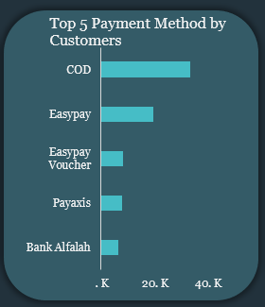
Payment Method Segmentation
Customers Preference Method –Data shows COD (33k), Easypay (19k), Easypay Voucher (8k), etc. as leading preferred payment platforms, among others.
Insight – Major growth in adoption of digital platforms (+63%, 2021 – 2022).
Notes:
Purpose: identity/know customers preferred payment methods and identity any issues with certain payment options
Insight: shows COD/Easy pay are most popular options and should be promoted or clearly visible during checkout to prevent cart abandonment. Issues with COD (although builds trust/cover other non-online customers) - higher operational costs e.g. charge for cash collection service, increased returns and cancellation rate/refuse orders, failed deliveries due to no financial commitments, longer cash conversion cycle for company to receive payments

Slide 10
Conclusions & Recommendations
Key insights –
Sales Trends: Peaks in December (£50M+) and April highlighting key periods for Mobiles & Tablets, Entertainment, and Appliances.
Geographical Performance: Southern region dominates sales (39%), while Northeast and West show growth potential.
Customer Loyalty: Top customers generate £7M of total revenue, with steady annual growth in repeat orders.
Payment Methods: Strong adoption of COD, but digital payment usage surged by 63% (2021-2022).
Recommendations –
Strategically, Sterling should focus on prioritizing popular products during peak sales periods while promoting underperforming categories to boost overall revenue. Expanding marketing efforts in regions (Northeast and West) with lower sales and enhancing loyalty programs to drive growth, while offering incentives for digital payments to reduce reliance on COD and streamline operations.

Slide 11
Thank You

